Slide 1
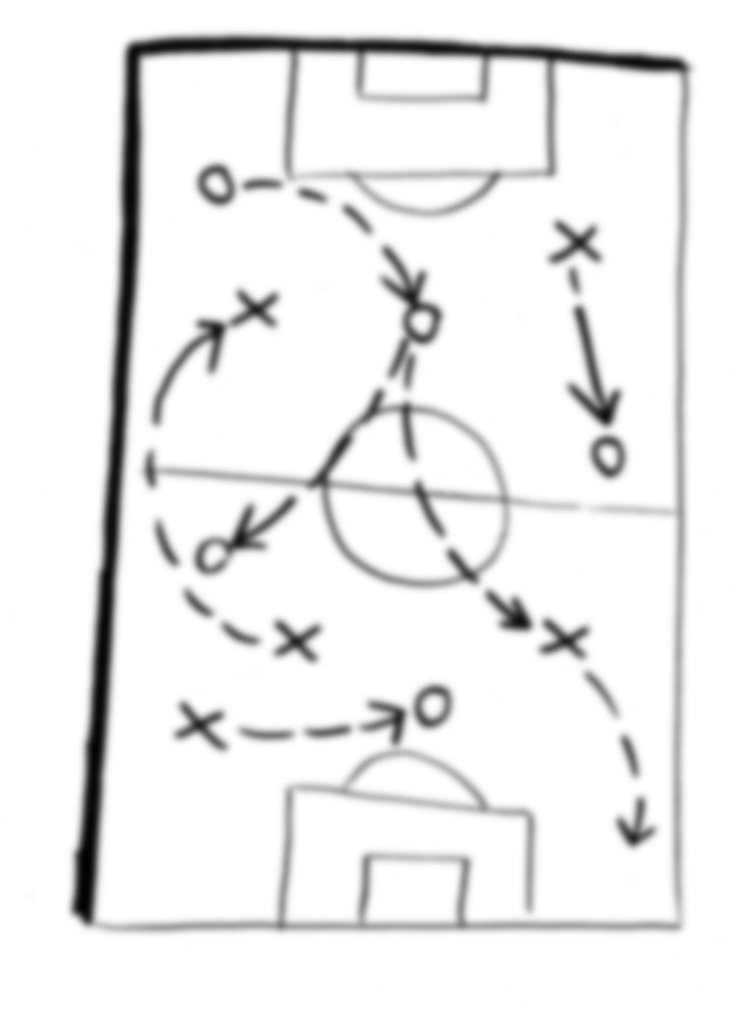
Your Playbook
geoff@geoffmazeroff.com
Notes:
About me… DAXOR, FSHFC, Twitter, Blog, e-mail
Think about a joke about group fitness – we’re all going to do pushups at the halfway point.
No Q&A – ask questions when they come to mind.

Slide 2
Inspiration
Is this for me?
What will I not get?
What can I take away?
Notes:
Context
◆
Software Lead Weekly – thoughtbot playbook
“Hello. You work at thoughtbot. This is your playbook. It details how you and your teammates run our software consulting company and how we make web and mobile products together. It is a living document that you can edit in a private GitHub repo. It’s filled with things we’ve learned based on our experience and study of other’s experiences.”
Examples: laptop setup, platforms, tools, sprints, planning process, design tools, dev processes (e.g., TDD), deployment, instrumentation, sales, hiring, operations, social media…
Everything was spelled out! It didn’t hold your hand, but you get a framework – a safety net.
Then I thought, “What would my playbook look like?”
◆
Yes, if you’re introspective and open to considering new things. You’re probably doing some of these things already. It doesn’t really matter what your day job is or how senior you are.
Every one of is in this room does things, even if it’s not explicitly laid out.
Hopefully this talk will get you to think about who you are and what works for you, and will give you some categorized tips/plays you can refer to when you get stuck.
Your playbook is not just for your career – it can be personal (finances, relationships, fitness).
◆
…too much detail; see the links in the slides after the talk, or reach out to me.
Silver bullets. These work for me, but might not for you.
◆
Thesis: I want you to think about curating a set of plays that match your unique values, and take comfort in knowing those plays are there for you when you need them.
Find out what seems to work for other people, and then think about how you would apply that to various situations.
I want to encourage you to get in the habit of thinking about what you do, and why you do it.
Your playbook is there to help you when you need grounding, and to help you break out of the loop of overanalyzing.
Resources:
https://playbook.thoughtbot.com/
http://softwareleadweekly.com/

Slide 3
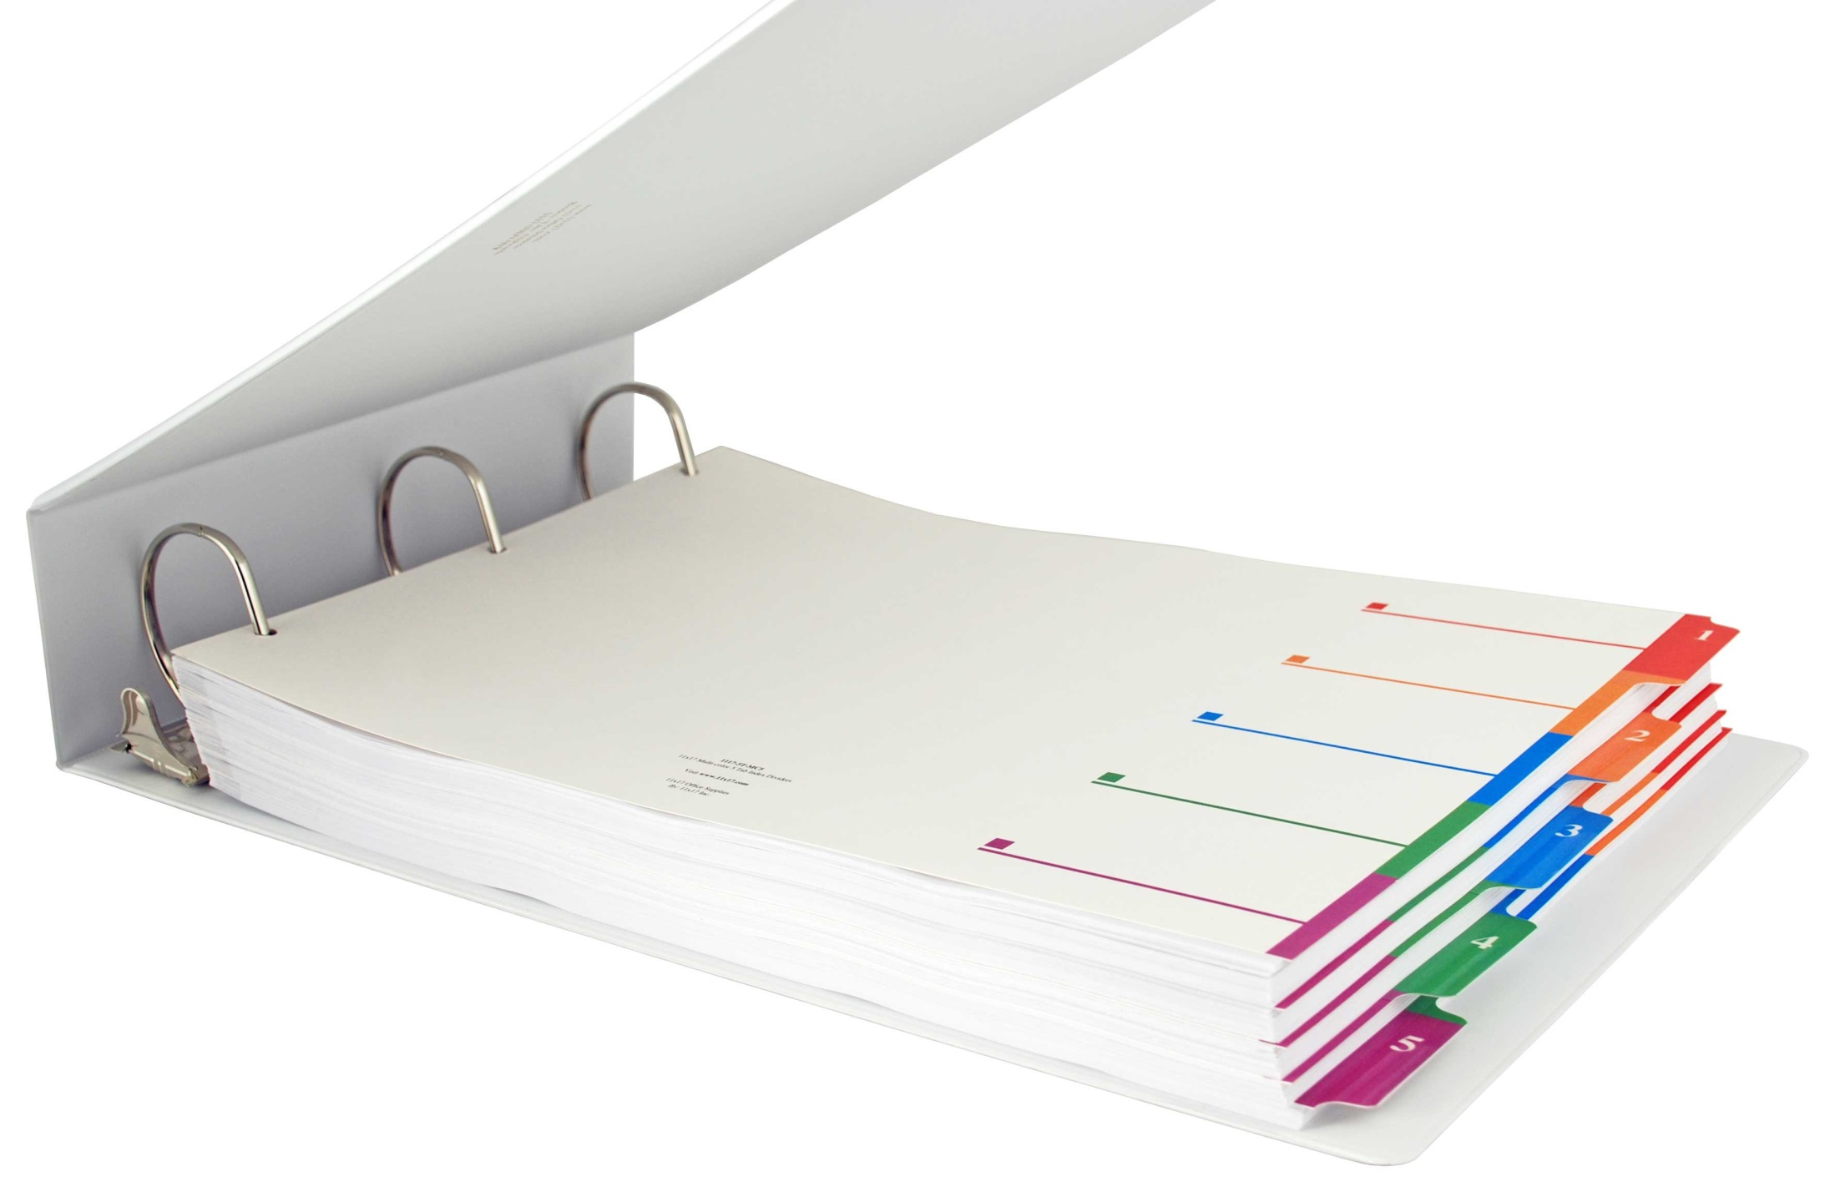
Values
Goals
General plays
Plays in motion
Notes:
Tabs in your playbook
◆
Values help define…
◆
…goals, which are fulfilled by…
◆
…processes. The processes are general plays that apply in a variety of situations.
◆
I’ll cover some common, concrete situations we find ourselves in, where we can use our general processes, plus a few other targeted ones to help us succeed.
You may have noticed the plays come at the end. The processes and scenarios only make sense based on your values and goals that you have found work for you. Your coworker’s plays may work great for her, but will tank for you because they don’t align with who you are. It’s important to do the work and put down on paper who you are and the patterns you keep reusing.

Slide 4
VALUES
Notes:
This section could be titled “know thyself.”
Again, this is not exhaustive – you can do some real, deep introspection here if you want.
I’m limiting it here to four areas…
Strengths
Roles
Interests
Beliefs

Slide 5
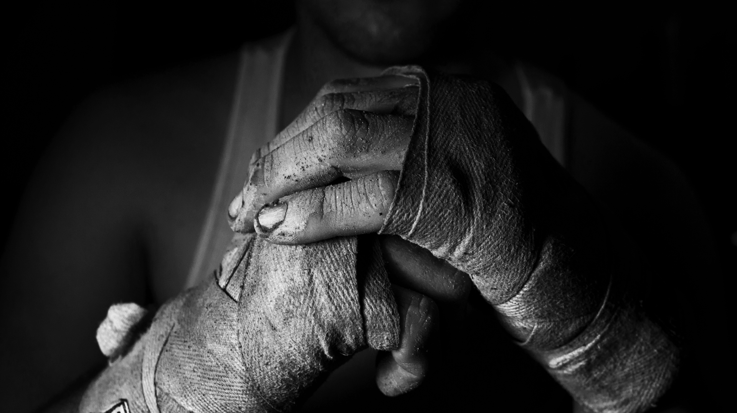
http://strengths.gallup.com
Discipline
Responsibility
Analytical
Consistency
Harmony
Notes:
Strengths
One of my managers pointed me to a book called “First Break All the Rules”, which aims to distill what works for managers and those being managed. The book mentions the concept of talent, where talent is a recurring pattern of thought, feeling, and behavior that can be productively applied. This is what drives you and defines how you think. The key here is that you play to these strengths instead of minimizing weaknesses.
The authors are consultants for the Gallup Organization, and they surveyed 80K managers in 400 companies. This was refined a bit and turned into StrengthsFinder 2.0. Gallup interviewed 1.7 million professionals in varying fields and quantified 34 different traits (talents). The book (~$15) describes all of the strengths, or you can spend $10 and take the assessment online. It’s a simple way to put a name/category to things that are in your wheelhouse.
◆
Discipline – a need for order and predictability
This is why I fit well in process-oriented environments, and why habit and routine factor into many aspects of my life.
This relates to why I even have a playbook. I like to have processes I trust.
◆
Responsibility – taking ownership for anything I commit to
This relates to discipline as well. If I’m impacting someone else, I want to make sure I do a good job and hold up my end of the commitment.
◆
Analytical – “Show me why what you are claiming is true”; data to make sense of things
Given my profession, this isn’t a surprise. My biggest battle is realizing I can’t analyze everything and must balance my own analysis with guidance from others.
◆
Consistency – balance; treating people fairly; rules applied to everyone equally
I have a healthy discontent for zero-sum games – for there to be a winner, someone must lose.
◆
Harmony – keep conflict to a minimum, look for areas of agreement
I’ve never been very competitive, and the concept of asking for forgiveness rather than permission doesn’t sit well with me. A related unofficial talent would probably be “supporter” – I work best when I’m the oil in the machine instead of being the engine.
◆
As you can see, these talents are not all mutually exclusive. Even the ones that are on opposite ends of the spectrum can be combined to balance each other out. For example, you may have someone who’s an Activator (jump in and get things moving) paired with someone who’s Deliberative (cautious, careful) to avoid either extreme and apply the best of both strengths.
Based on these talents, I find myself getting into recurring roles…
Resources:
http://www.amazon.com/First-Break-All-The-Rules/dp/0743510119
http://www.amazon.com/StrengthsFinder-2-0-Tom-Rath/dp/159562015X
http://www.geoffmazeroff.com/2015/07/17/strengthsfinder-assessment-results/

Slide 6
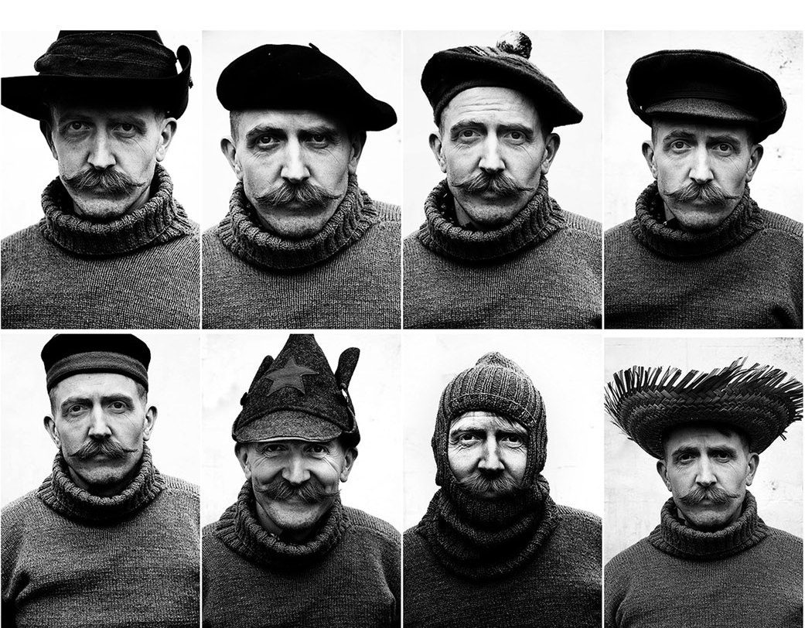
Librarian
Clerk
Custodian
Coach
Mentor
Ambassador
What about you?
Notes:
Roles
Librarian – go-to source for knowledge
Clerk – keep track of things (goes with discipline)
Custodian – avoiding the Tragedy of Commons by doing upkeep
Coach – remind people they can achieve with the right effort
Mentor – giving others a path, but letting them traverse it themselves
Ambassador – representing an individual or team to others
Some other roles that I’ve tried to play (but not all that well because of experience/training):
Metricant – deciding what to measure and surfacing that data
Marketer – making a solid pitch for something and building desire for what you have to offer
◆
?: What are some roles you find yourself returning to?
Resource: https://flowchainsensei.wordpress.com/2011/02/25/the-many-roles-in-software-projects/

Slide 7
Architecture & design
Process
Cognitive & social psychology
What about you?
Notes:
Interests
◆
I enjoy knowing how things are put together and how components relate. Design also applies to physical objects or user interfaces – there are countless creative ways to solve problems… Why was this way chosen?
?: How many of you got in trouble as a kid for taking things apart?
◆
I love understanding how things work – process and workflows make this possible.
◆
Psychology – we usually build for and work with people, so understanding biases and behaviors is helpful
◆
What are your underlying interests?

Slide 8
Could != should
Ratio of others to self
If everyone you encounter is an asshole…
Be a multiplier
What about you?
Notes:
Career-oriented beliefs
◆
Learn and listen about your choices. Evaluate them critically, then decide for yourself.
◆
This goes with my harmony and responsibility talents. Is what I’m doing benefitting others or just me?
◆
Ask yourself whether your assumptions are correct. For example, if every task management technique has failed, is it really those systems or the way you think about the work? High turnover rate is another example.
◆
Comes from Sean Cassidy’s post “You are not a 10x developer”. Make other people shine.
◆
What are things that give you a foundation for your identity?
Resource: https://www.seancassidy.me/you-are-not-a-10x-developer.html

Slide 9
Goals
General
Time-oriented
Notes:
Our strengths, roles, and interests, and beliefs define our identity. Next, we set some goals that align with that identity and give us some purpose.
◆
Some of my general goals
Maintain healthy relationships
Learn and be inspired
Be active and engaged in software to do awesome things and help people
Be part of a larger community
Share things I’ve learned and been inspired by
Be / stay fit
Honor commitments
◆
Some of my yearly goals
Plan a wedding and get married
Get advanced certs in group fitness
Find some devs I can do a side project with
Speak at a conference
Replace the kitchen table/chairs

Slide 10
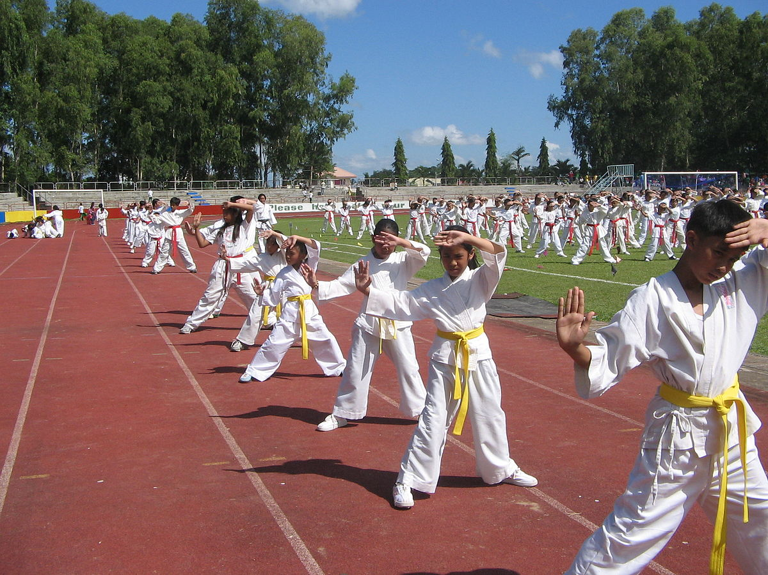
General Plays
Notes:
This set is not exhaustive – it’s a collection of plays I keep coming back to and have made into habits.

Slide 11
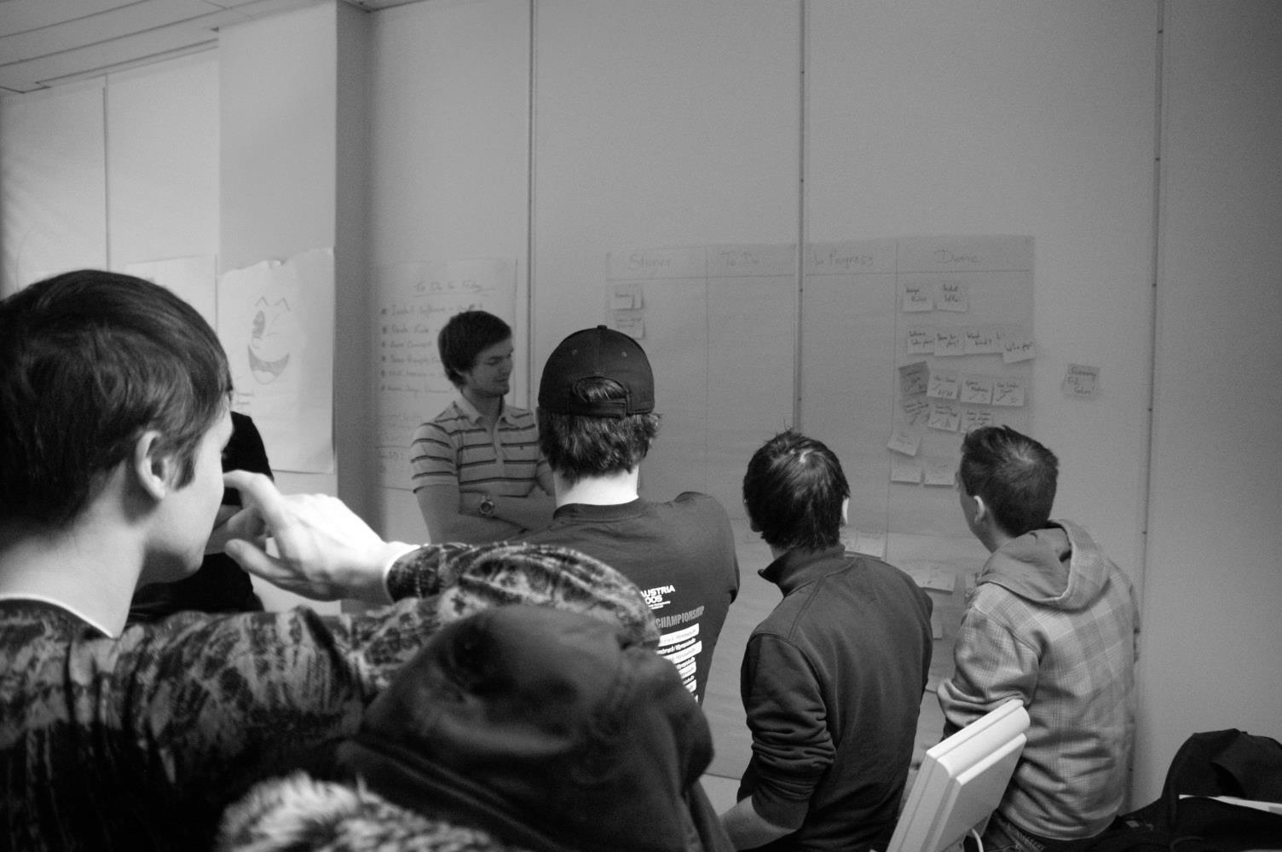
Start with over-communication, then tune
Choose your medium
Competition still has its place
Notes:
C&C
I stole this term from my boss – communication and collaboration.
Communication is so integral to everything we do.
Employees
Customers
Other developers
Ourselves (through code)
Agile manifesto – “individuals and interactions” and “customer collaboration”
◆
This quotation is from a TED talk titled: “Why it’s time to forget the pecking order at work”:
“Some groups do better than others, but what's key to that is their social connectedness to each other.
So how does this play out in the real world? Well, it means that what happens between people really counts, because in groups that are highly attuned and sensitive to each other, ideas can flow and grow. People don't get stuck. They don't waste energy down dead ends.”
◆
What channel is your recipient listening on?
◆
Resource:
http://www.ted.com/talks/margaret_heffernan_why_it_s_time_to_forget_the_pecking_order_at_work/

Slide 12
Prefer short cycles
Part of build/measure/learn
Make this information come to you
Notes:
Feedback
If you’re not getting this, seek it out.
◆
The longer you wait to see if you need to correct course, the harder it is to do so.
◆
This is from Eric Ries’ “The Lean Startup”. The goal is to get through the build/measure/learn cycle as quickly as possible
◆
Put this on autopilot. For example, a continuous integration server.

Slide 13
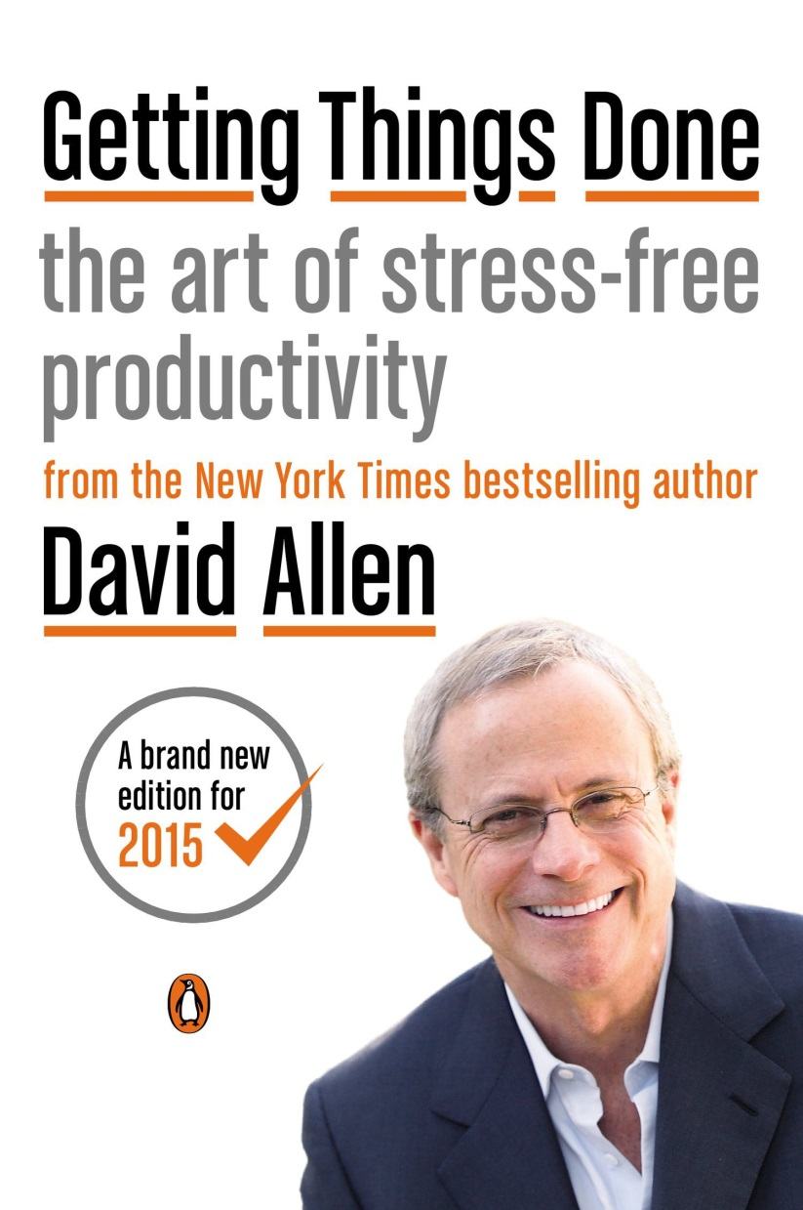
Use a system you trust
Four Ds
Do
Delegate
Defer
Delete
Notes:
Getting Things Done
Credit to Brian Prince from CodeStock 2009
Your brain should be used for thinking, not remembering.
If you have some well-defined process to manage tasks, your mind is more free to think about perspective (i.e., how you are progressing toward your goals).
If you can get your day-to-day “runway” of actions under control, you can start thinking about short-, medium-, and long-term goals. The thing that makes this system work for me is that it has concrete steps to establish a workflow.
◆
My systems involve Google Calendar, Trello, and Evernote. I have a two-part blog series that goes into way more detail.
◆
Resources:
http://www.amazon.com/Getting-Things-Done-Stress-Free-Productivity/dp/0143126563
http://www.geoffmazeroff.com/2014/10/25/productivity-process/
http://www.geoffmazeroff.com/2014/10/28/productivity-process-part-2/

Slide 14
Human brains usually suck at remembering elaborate sequences
The Checklist Manifesto by Atul Gawande
Great segue for automation
Notes:
Checklists
◆
Use your brain for reasoning, not recall.
◆
Even doctors with all their training and pilots with hundreds of logged flight hours rely on checklists to prevent seemingly mundane but costly errors.
Trello is an awesome tool for implementing this.
?: Who here has the “build dance”, with the complex series of steps to build/deploy?
◆
Resources: http://www.amazon.com/Checklist-Manifesto-How-Things-Right/dp/0312430000/

Slide 15
Recurring tasks
Be ready for the next thing
Time for yourself
Leave space
Notes:
Schedule
◆
Take your favorite calendar and set yourself up on schedules so that you don’t miss things.
Rely on your calendar to remember, rather than your brain.
This is great for things that always happen on the same day of the month or twice a year.
Example: Forgetting to turn in a time sheet, scheduling dentist appointments, reviewing financial goals (quarterly).
◆
Be ready for the next thing – If there’s an event that happens at a specific time, make sure you’re ready for that before tackling other stuff.
When I’m teaching class the next day, I make sure my gym bag is packed and I’ve reviewed music/choreography.
When there’s a demo I’m presenting at 2pm, I make sure to get my ducks in a row (projector, test data, etc.) first thing when I come in to the office.
◆
Maybe you have some goals for this year to write blog posts, or learn about building something with a Raspberry Pi. Go ahead and block out time for those.
◆
Be sure to build in time to rest.
Personal gripe against “time is money”, so all time must be maximized. That establishes time poverty: “Once hours are financially quantified, people worry more about wasting, saving or using them profitably. When economies grow and incomes rise, everyone’s time becomes more valuable. And the more valuable something becomes, the scarcer it seems.”
“Music is the space between the notes” – Claude Debussy
Like interval training, the rest phases are just as important as the efforts. It’s about quality, not quantity.
Resource: http://www.geoffmazeroff.com/2015/03/10/time-poverty/

Slide 16
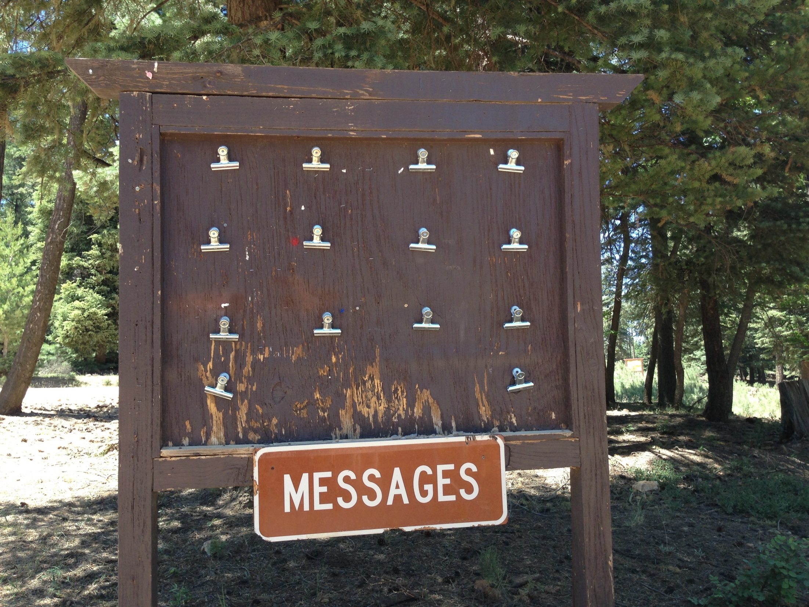
Notes:
Inbox Zero
(Merlin Mann) Keep your inbox empty (or as near to empty as possible). The “zero” is the amount of time you want to spend thinking about your inbox.
I implement this through GTD (do/delegate/defer/delete).
It’s refreshing to end each day with an empty queue. YMMV of course; remember, this is a collection of things that work for me.
Resource: http://whatis.techtarget.com/definition/inbox-zero

Slide 17
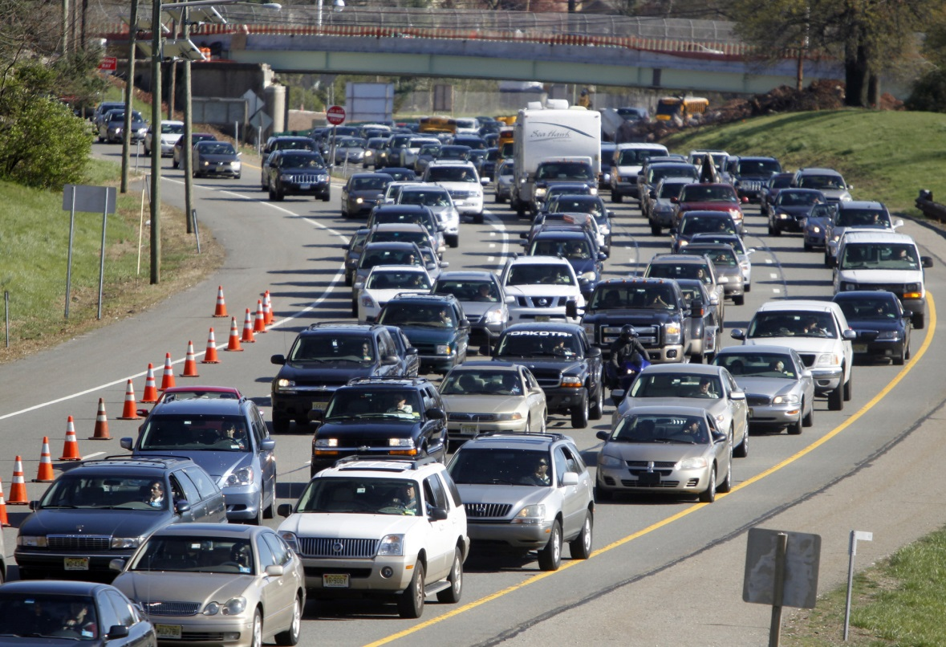
Notes:
Don’t Be the Bottleneck
“The throughput of any system is determined by one constraint.” – Eli Goldratt, The Goal
Your system can only go as fast as the slowest part.
Personally I don’t like knowing that there is work that can’t be done because I’m the hold-up.
Example: If there’s work ready for me to review, I try to prioritize that so that it doesn’t slow down getting work to QA.
If you’re interested in learning more, look up kanban or theory of constraints.

Slide 18
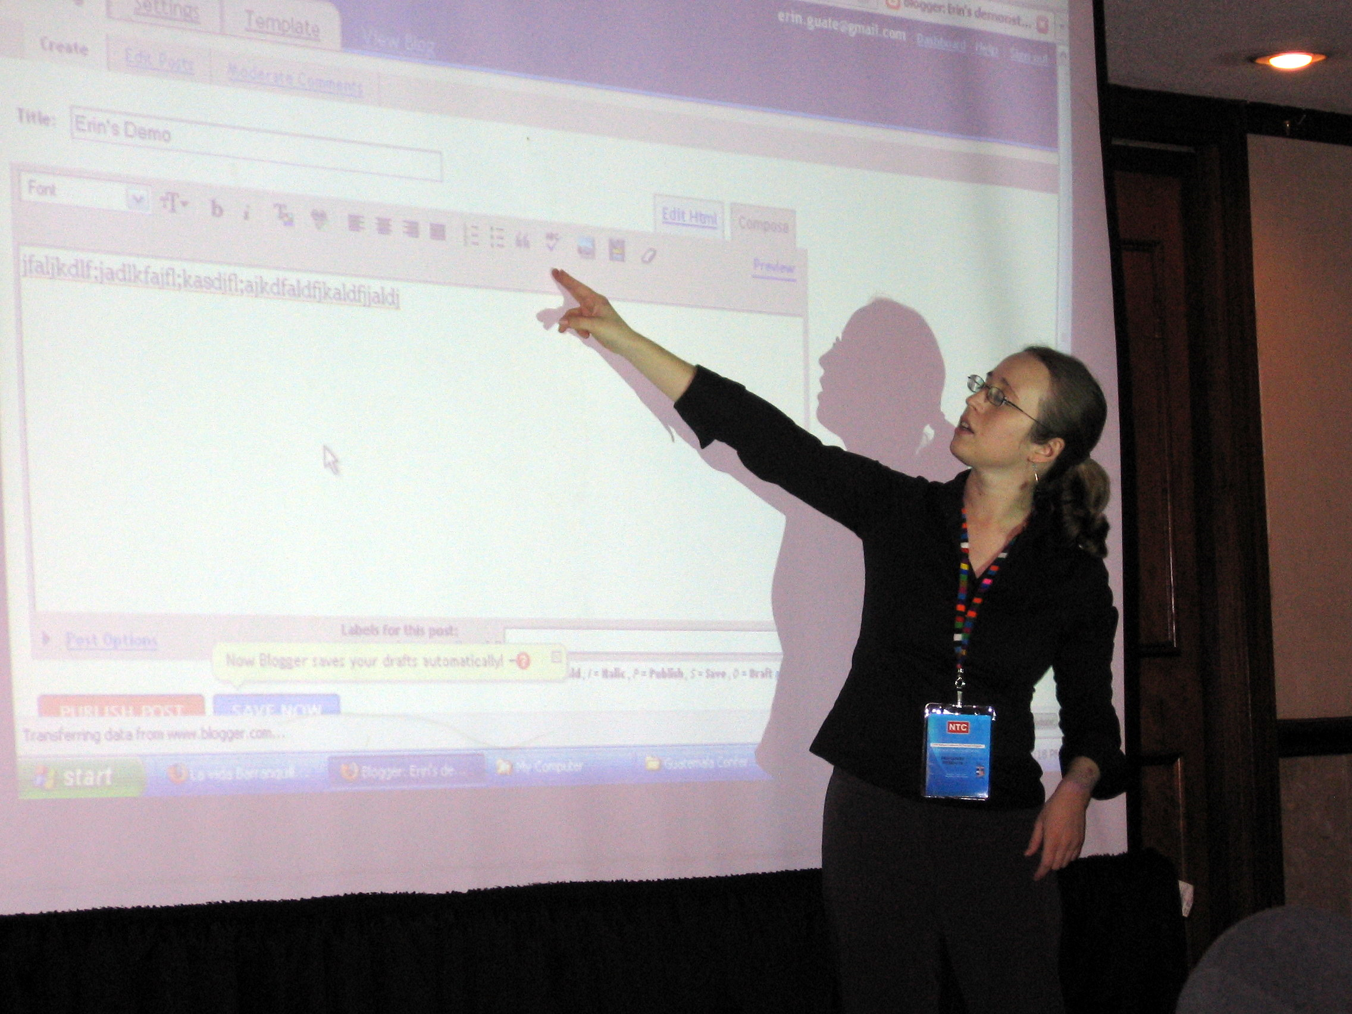
“If nobody knows you did {X}, did you get all the benefits of doing {X}?” – Jeff Atwood
Notes:
Do It in Public
This goes back to C&C and sharing your work with others.
◆
Examples:
Blogging
Read a book and write Cliff’s Notes versions as a post
“What I learned this week” posts
Code repos
Lunch-and-learn talks
YouTube videos
This is tangentially related to “eat like a bird, poop like an elephant” (Guy Kawasaki). Be a voracious consumer of information, and spread knowledge liberally.
This also helps you get feedback.
Resources:
https://www.youtube.com/watch?v=L7EGIt3-WUQ

Slide 19
Notes:
Clean as You Cook
This is basically small batch sizes (from lean manufacturing).
You do the cooking and clean-up work more or less in parallel so that everything finishes at the same time.
Some developer analogues:
Test-driven design – instead of cooking (dev) then cleaning (testing), you do small amounts of both at the same time. At any point you stop, the kitchen (codebase) is clean.
When you’re in a particularly messy section of code for some other reason (cooking), rename a variable here, refactor a method there (cleaning). You don’t need to clean the entire kitchen floor to ceiling – just the areas you work with.

Slide 20
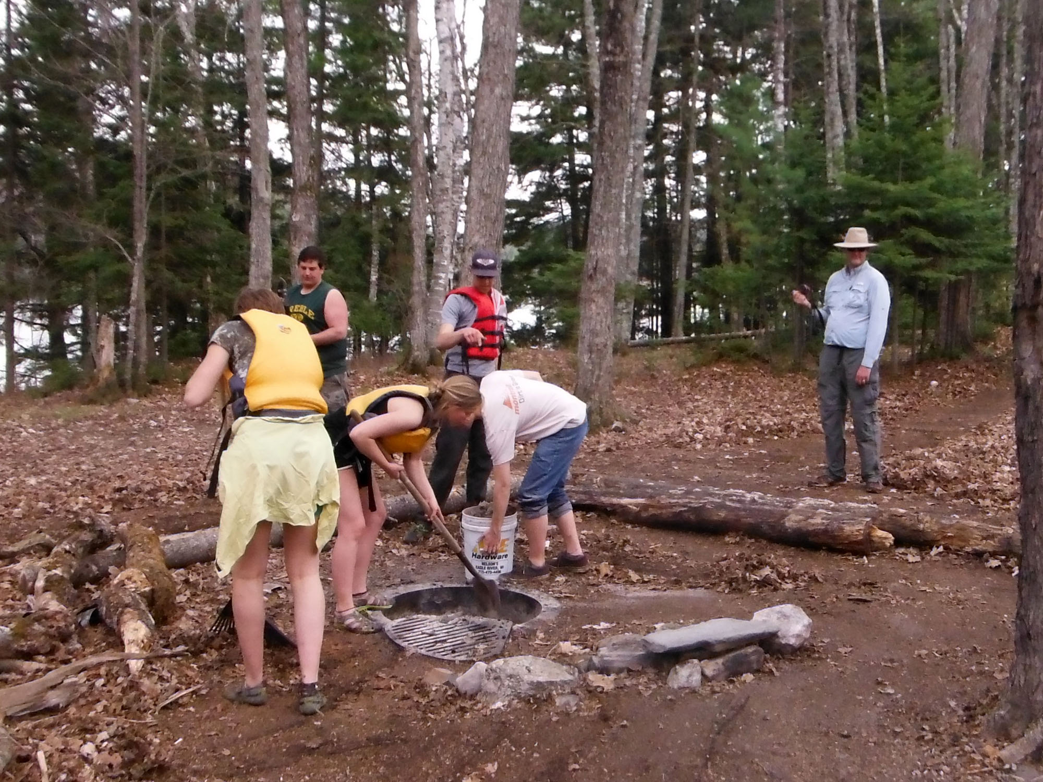
Notes:
Boy Scout Rule
?: Do you remember what the rule is?
Leave the campground cleaner than you found it.
Your campground is your code.
Just like cleaning as you cook, you don’t have to do everything; just make something a little better than you found it.
If you set that behavior as the norm, others will be likely to follow suit (or at least think twice before leaving a mess).
Resources:
http://pragmaticcraftsman.com/2011/03/the-boy-scout-rule/

Slide 21
Plays in Motion
Notes:
Now that you’ve spent time thinking about your identity and the general plays for your playbook, realize that these are habits and are in your back pocket to give you a foundation for when situations arise.
For your homework (building out your playbook), hold these situations in your mind and visualize yourself in that scenario. What do you see? How do you feel? The feel part is important because the plays are going to help redirect negative feelings or build on positive ones. Really use that.

Slide 22
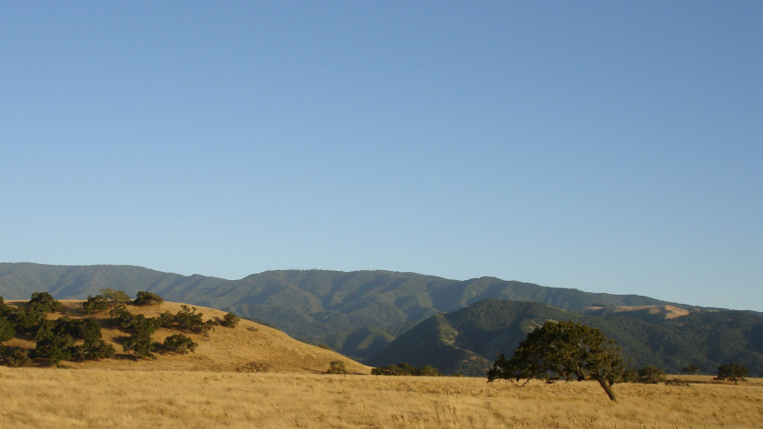
Find a vantage point
Narrow your focus
Think globally
Have backup plans
Work with others
C&C
Notes:
You’re in New Territory
◆
Get to high ground and get your bearings so that you can see what you’re up against.
◆
Just like water, food, and shelter are a priority, think about what needs to be tackled first. Remember that priorities change depending on your context.
◆
Always keep that global goal in mind. Distractions may lure you away as you encounter local maxima. On that note, if you encounter one of those, have triggers on when to stop digging.
◆
Because this is a new area, failure is likely. What would you do if that happened? Think about these before acting.
◆
It’s likely that other people have been in this situation before. Reach out to your community. If someone on your team has experience, pair/mob programming is an excellent tool.
On that note…
◆
…keeping others informed about how well you’re faring is helpful. Nothing’s worse then sending someone out to the deep end and then have 3 weeks of radio silence. Document (publically!) what you learned so that others don’t have to stumble in the dark.
Resource: http://www.geoffmazeroff.com/2015/01/16/developer-as-survivalist/

Slide 23
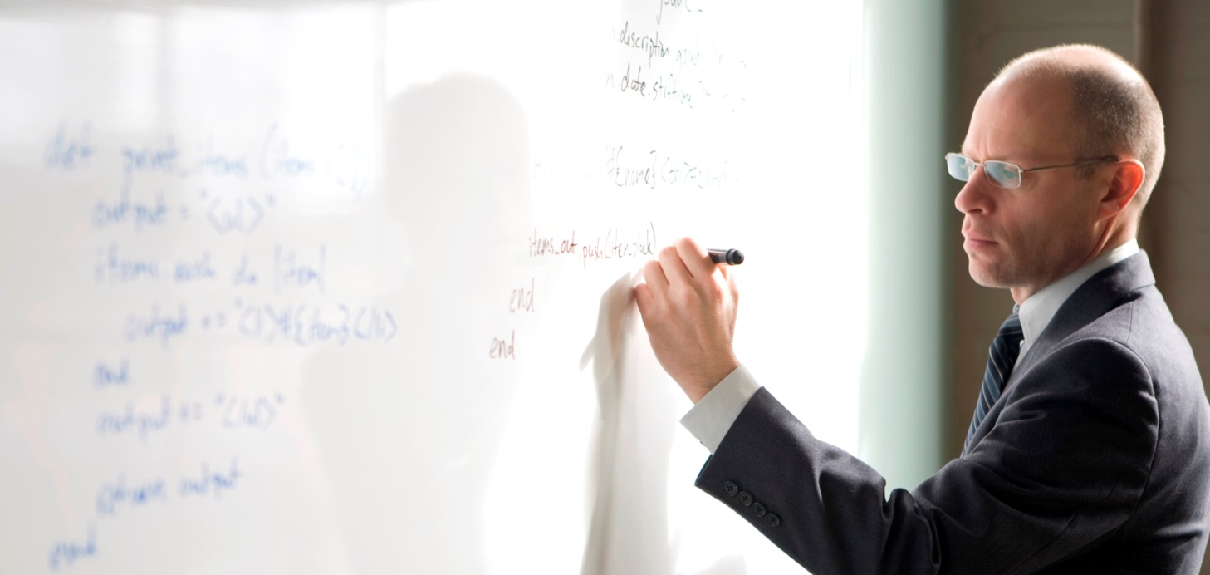
Riskiest thing first
Small batches
C&C
Build in feedback
Prioritize things where you’re the bottleneck
Notes:
You Need to Plan a Project
◆
This is like addressing a bottleneck. What the part (assumption) that if you’re wrong will cause the most damage? For example, evaluating a replacement piece of hardware for my job…
◆
This is basically agile and lean. Build/measure/learn in small steps so you can adapt to change. Remember the idea of small batch size can seem counter-intuitive, but is essential to being adaptive.
Now we can bring in some of those general plays from before.
◆

Slide 24
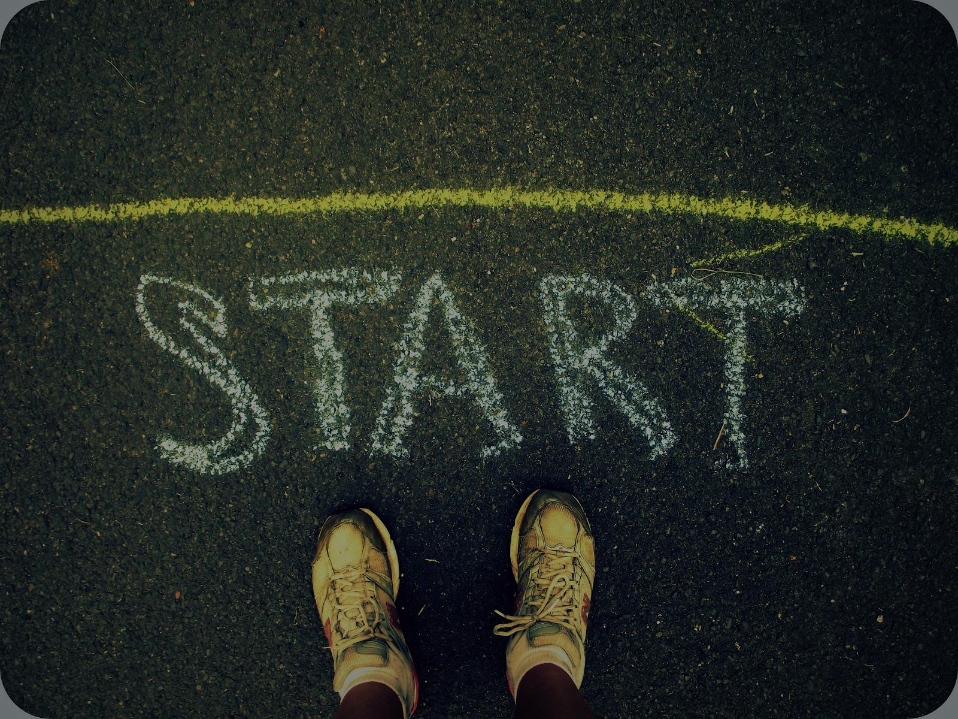
“Use what talents you possess; the woods would be very silent if no birds sang there except the ones that sang best.” – Henry van Dyke
Notes:
You’re Considering Starting Something
Things that come to mind are blogging, teaching, working on a task management app, or speaking at an event.
◆
Just because someone else has done it doesn’t mean there no value in you doing it.
Advice: Go for it!
Sometimes there’s value in building something from scratch (reinventing the wheel) – you learn how to put things together for yourself.

Slide 25
Introduce yourself
Cross-pollinate
Diversify
Notes:
You Just Got Hired
There’s the obvious stuff of user accounts, meeting schedules, submitting timesheets. Let’s go beyond that…
◆
Get to know others, not just the other devs. This plays to my interests/desire to work at a small company. I get to understand what people do and why they do it – what makes them light up (or get upset).
◆
Inter-department projects can be a win-win – you get to learn more about how their end of the business works all while building trust (and something helpful for them to use). Recall that one of the processes I mentioned earlier about “being a multiplier”.
◆
The greater variety of people you work with, the better. You get different perspectives and learn different lessons.
Practically speaking, the more people that have seen you code, the more references you have for future work in or outside the company.

Slide 26
Base camp
What do I give?
Do I belong here?
Can we all grow?
Notes:
Staying Happy at Your Job
◆
Do I know what's expected of me
Do I have the materials/equipment needed to do my job right?
Do I have the opportunity to be my best every day?
◆
In the last 7 days, have I received recognition or praise for doing good work?
Do my supervisor or coworkers seem to care about me as a person?
Is there someone who encourages my development?
◆
Do my opinions count?
Do the mission/vision/purpose of my company make me feel my job is important?
Are my coworkers committed to doing quality work?
Do I have a best friend at work?
◆
In the last 6 months, has someone talked to me about my progress?
In the last year, have I had opportunities to learn and grow?
Recall my “scheduling” play? This is a good one to put in the calendar to self-audit.
Resource: http://www.amazon.com/First-Break-All-The-Rules/dp/0743510119

Slide 27
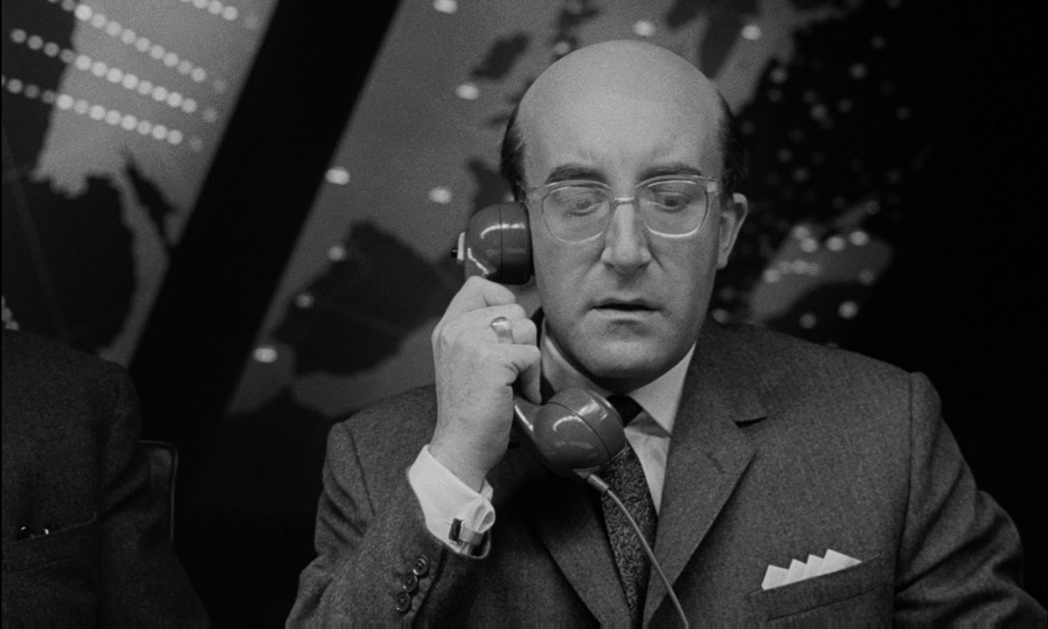
Stabilize the situation
Don’t act from panic
SAFTK
Reflect
Notes:
You’re in an Oh-shit Situation
“You know how we’ve always talked about the possibility of something going wrong with the bomb.”
◆
Stop any more damage from occurring.
◆
When we get emotionally charged, logic goes out the window. Breathe.
◆
(From Jim Holmes’ talk at Kalamazoo X) -- step away from the keyboard
◆
Could this have been avoided?
Origins: http://www.pluralsight.com/courses/technology-careers-dark-side

Slide 28
Touchstones
Get physical
Change scenery
How do you recharge?
Notes:
You’re Feeling Blah
We’ve all had times where we’re just not feeling it. The body may be willing, but the brain is not.
◆
TED videos, articles, music
◆
Endorphins are good, and they say sitting is killing us anyway. My technique is a win-win because I exercise to music.
◆
Sometimes just a change of venue (visuals, soundscape, ambience) will stimulate you. The precursors to this talk did not start at my desk.
◆
Maybe you have lunch with a friend, take a nap, read a campy book, or watch 20 minutes of that training video you’ve been itching to watch.
Remember how I said that the music is the space between the notes? Our work is inherently creative, so your downtime is just as important.

Slide 29
Smaller tasks
Pomodoro
Where are you focusing?
Ask for help
Notes:
You’re Procrastinating
Again, a caveat – everyone’s an expert on this, right? Here are things that help get me moving again.
◆
Like in GTD, most work seems intimidating because the scope is too broad. Break things into actionable tasks, even if it’s a larger one like “brainstorm”.
◆
25 minutes, and then stop. It’s concrete, achievable, and finite. This gives you momentum by having done something.
◆
Envision the work, not the end. Our brains can trick us by rewarding us for mentally having crossed the finish line even though we haven’t even put on our running shoes.
◆
This is why it’s helpful to have communities. None of us is operating at 100% all the time – borrow some of that energy from others.
Resource: https://blog.bufferapp.com/how-our-brains-stop-us-achieving-our-goals-and-how-to-fight-back

Slide 30
Vanishing options test
Process vs. tech
Diversify
Notes:
You Need to Think Long Term
This is more about long-term career thinking.
“Your career is a balance between obsolescence and progress.” – Dan Appleman
◆
Here’s a question for you to ask yourself: What would happen if X disappeared? X could be a vendor for your product, a tool you use for development, your even your employer.
◆
Processes – ways of thinking – have longer shelf-lives than tools/tech. Obviously you need to have some skills, but don’t bet everything on them.
◆
Ways to diversify:
Don’t just write code – design, architect, document, deploy, market. These skills are harder to off-shore.
Get solid on fundamentals – patterns, code smells, *DD
Work on soft skills
Back to C&C… management and people-skills in general have more staying power than any technical skill

Slide 31
What would have to change?
Play Devil’s Advocate
Make a tripwire list
Notes:
You Have to Make a Decision
We make so many decisions and try to logically weigh the alternatives. Here are some tips I picked up from a book called “Decisive” by Chip and Dan Heath.
◆
What would have to change for X to be true?
◆
The role of Devil’s Advocate comes from the Roman Catholic Church. This person is a lawyer appointed to argue against canonization of a candidate (e.g., he was a great pope, why wouldn't he be sainted?).
The Devil’s Advocate deeply respects the system by surfacing contrary arguments in situations where skepticism is unlikely to surface naturally.
◆
Use your calendar – something needs to get done by a certain date (or X days/weeks from now)
Revisit on a regular basis if these are intermittent (example: when my emergency fund gets to $X, then I’ll put money toward ABC)
Share this list with others if it impacts more than just you (e.g., your team). Example: when a process takes more than X minutes for Bob to do, then we should buy that productivity tool we discussed.
Resources:
http://www.amazon.com/Decisive-Make-Better-Choices-Life/dp/0307956393/

Slide 32
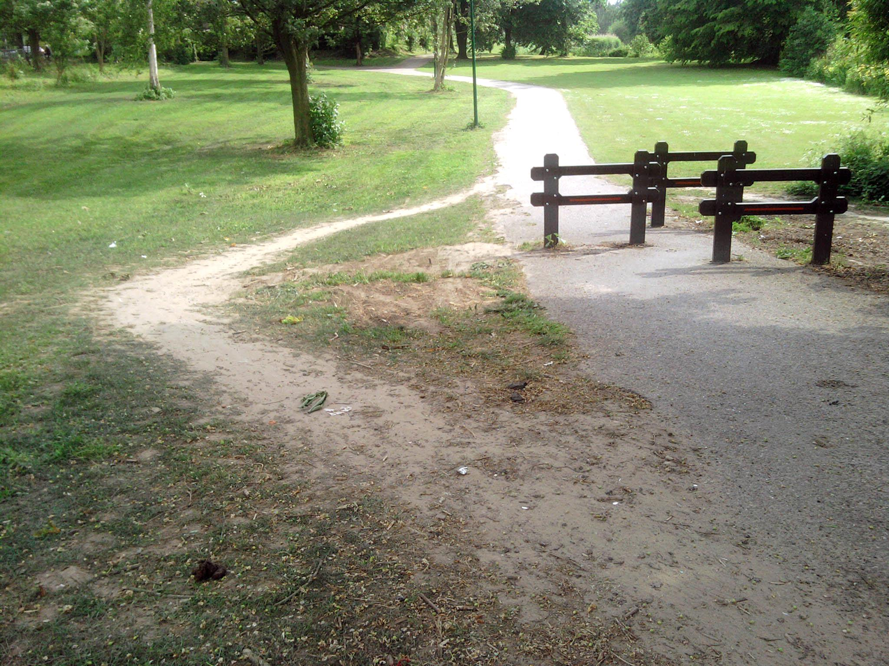
Business case
Ask around
What would it take to…
Notes:
You Want to Change Something
There’s that trusty adage: “Change where you work, or change where you work.”
◆
Can you translate it into a dollar amount? (see http://www.pluralsight.com/courses/making-business-case-for-best-practices)
◆
Maybe someone else has been in the same situation. This is a great way to find allies (and to identify opponents).
◆
Sometimes putting the question to the other person forces them to put into words what the barriers are, and also signals to them that you’re dedicated and open.

Slide 33
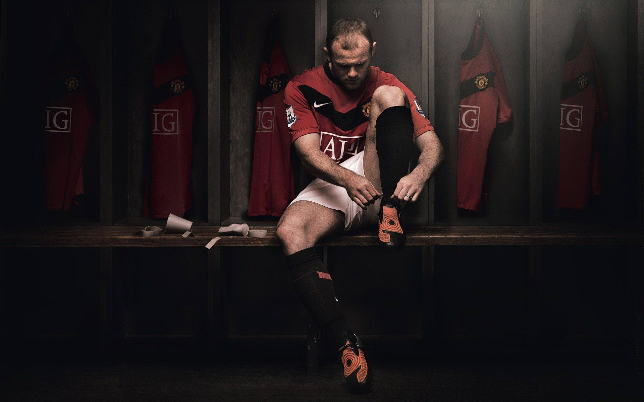
Values, goals, general plays, plays in motion
Make it yours
…and share it with others
Notes:
Huddle Up
Here are the main sections
◆
I want you to think about curating a set of plays that match your unique values, and take comfort in knowing those plays are there for you when you need them.
Find out what seems to work for other people, and then think about how you would apply that to various situations.
I want to encourage you to get in the habit of thinking about what you do, and why you do it.
Your playbook is there to help you when you need grounding, and to help you break out of the loop of overanalyzing.
Remember to revisit and alter plays as needed (every 6 months)
Feel free to borrow some pages out of my playbook. But remember, you are your own person.
◆
And just like Jeff Atwood said, “Do it in public.”
I look forward to learning from your playbook, so feel free to get in touch.
◆

Slide 34
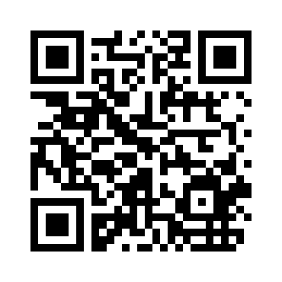
Your Playbook
geoff@geoffmazeroff.com

Slide 35
Other Plays in Motion
You’re working in a silo
You need to produce written material
You’re an ambassador
You need to respond quickly to change
You’re learning something new
You’re asked for an estimate
You need to motivate others
You’re starting a new process
You just hired somebody
Notes:
Siloed area (mob/pair, lunch and learn, document and share)
Written material (proofread, text-to-speech)
Being an ambassador (know your stuff & what you don't know, be proactive in sharing state/knowledge, find others in your network (where you can get info), you represent X not just yourself (mindset))
Responding quickly to change (small batches, can you make your work smaller, another tangential example is preventative maintenance - a little work at a time vs. huge dumpster fire later)
Managing your learning (set goals for the year, carve out time - 15 min/day or 2 hrs/weekend, make it small/concrete, change up areas of learning, use your network to find what/where to learn, practice, get feedback (Talent is Overrated reference to "deliberate practice")
Asked for an estimate (promise what you can control, Peopleware: estimates more effective if they come from people doing the work)
Motivating others (empathize, do they need side by side / someone to lead / someone to push from behind, explain why, get on their level)
Manage others (manager or leader, there are no B players (Daniel Tenner), select for talent, set expectations by defining outcomes, focus on strengths, develop that person)
Starting a new process (be disciplined, people are looking to/at you, measure, proactive communication, get ready to delegate/automate/formalize)
Just hired someone new (reach out, establish (with priorities) what they need to learn to be successful quickly, pair program, give them a playbook)

Slide 36
Books
http://www.amazon.com/StrengthsFinder-2-0-Tom-Rath/dp/159562015X
http://www.amazon.com/First-Break-All-The-Rules/dp/0743510119
http://www.amazon.com/Lean-Startup-Entrepreneurs-Continuous-Innovation/dp/0307887898/
http://www.amazon.com/Getting-Things-Done-Stress-Free-Productivity/dp/0143126563
http://www.amazon.com/Checklist-Manifesto-How-Things-Right/dp/0312430000/
http://www.amazon.com/Goal-Process-Ongoing-Improvement/dp/0884271951/
http://www.amazon.com/Decisive-Make-Better-Choices-Life/dp/0307956393/

Slide 37
Articles & Videos
https://playbook.thoughtbot.com/
http://softwareleadweekly.com/
https://flowchainsensei.wordpress.com/2011/02/25/the-many-roles-in-software-projects/
https://www.seancassidy.me/you-are-not-a-10x-developer.html
http://www.ted.com/talks/margaret_heffernan_why_it_s_time_to_forget_the_pecking_order_at_work/
http://www.geoffmazeroff.com/2014/10/25/productivity-process/
http://www.geoffmazeroff.com/2014/10/28/productivity-process-part-2/
http://www.geoffmazeroff.com/2015/03/10/time-poverty/
http://whatis.techtarget.com/definition/inbox-zero
https://www.youtube.com/watch?v=L7EGIt3-WUQ (Jeff Atwood - How to Stop Sucking and Be Awesome Instead)
http://pragmaticcraftsman.com/2011/03/the-boy-scout-rule/
http://www.geoffmazeroff.com/2015/01/16/developer-as-survivalist/
http://www.pluralsight.com/courses/technology-careers-dark-side
https://blog.bufferapp.com/how-our-brains-stop-us-achieving-our-goals-and-how-to-fight-back
http://www.pluralsight.com/courses/making-business-case-for-best-practices

